Slide 1
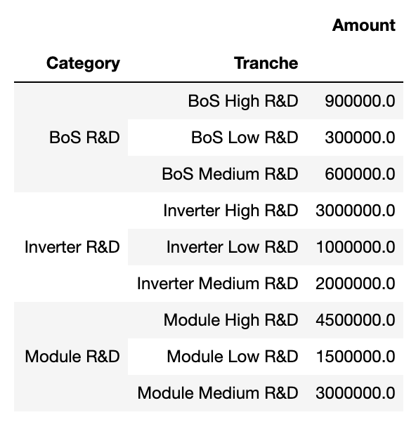
BoS Inverter Module
Increased Labor GHG Reduction LCOE Reduction

